Slide 1
Chronic Kidney Disease Prediction
Using Machine Learning Algorithms

Slide 2
Agenda :
Introduction
Understanding Chronic Kidney Disease
Challenges and Limitations
Machine Learning for Chronic Kidney Disease
Technologies used
Data pre-processing
Testing and training the Model
Choose Machine Learning Models
Support Vector Classifier
Decision Tree
Understanding random forest classifier
User interface
Result
Conclusion

Slide 3

Introduction :
Chronic kidney disease (CKD) is a condition in which the kidneys gradually lose function over time.
Early detection and prediction of CKD is crucial because it allows for timely interventions to slow or even prevent disease progression. Here are some specific reasons why early detection and prediction of CKD is important:
Delaying the progression of CKD
Preventing complications
Identifying the underlying causes of CKD
Improving the quality of life
Cost savings

Slide 4
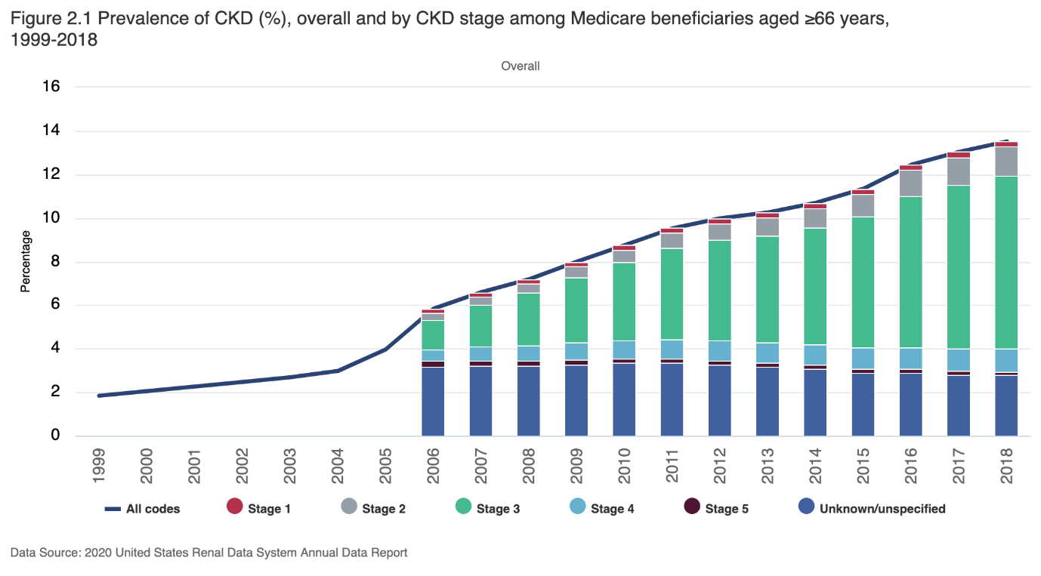
Understanding Chronic Kidney Disease :
CKD is usually diagnosed by measuring the level of a waste product called creatinine in the blood. Creatinine is produced by muscles and is normally filtered out of the blood by the kidneys. As kidney function declines, creatinine levels in the blood rise. Other tests, such as urine tests, can also be used to diagnose CKD and monitor its progression.
The severity of CKD is determined by the estimated glomerular filtration rate (eGFR), which is a measure of how well the kidneys are functioning. An eGFR of 90 or above is considered normal, while an eGFR of less than 15 is considered very severe.

Slide 5
Challenges and Limitations :
Data quality: ML algorithms require large amounts of high-quality data to train accurately. However, CKD data is often incomplete, inconsistent, or missing key information, which can reduce the accuracy of the models.
Data bias: The accuracy of ML models can be affected by biases in the data used to train them. For example, if the training data contains more cases of CKD in certain demographics, such as men or people of a certain age, the model may be less accurate when applied to other demographics.
Limited generalizability: ML models may not generalize well to new populations or settings, particularly if the data used to train the model is not representative of those populations or settings.

Slide 6
Machine Learning For Chronic Kidney Disease :
ML has the potential to revolutionize CKD prediction by providing more accurate and personalized risk assessments, identifying individuals who may benefit from early interventions, and improving our understanding of the underlying mechanisms of the disease.
Predicting CKD risk: ML models can be trained on large datasets of patient information to predict the risk of CKD in individuals. These models can take into account factors such as age, sex, blood pressure, and other medical conditions to identify those who are at higher risk of developing CKD. This information can help healthcare providers intervene early to prevent or slow the progression of the disease

Slide 7
Technologies and Libraries Used :
Jupeter Notebook
Python Libraries :
Pandas
Numpy
Matplotlib
Sklearn
Seaborn
Pickle

Slide 8
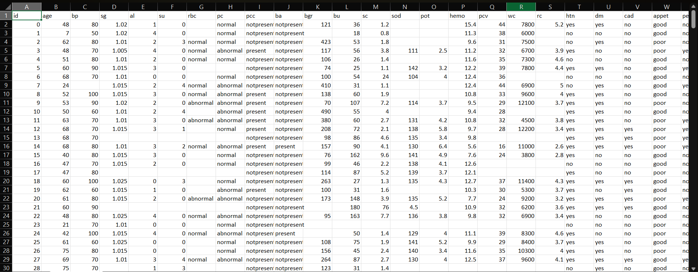
Dataset :

Slide 9
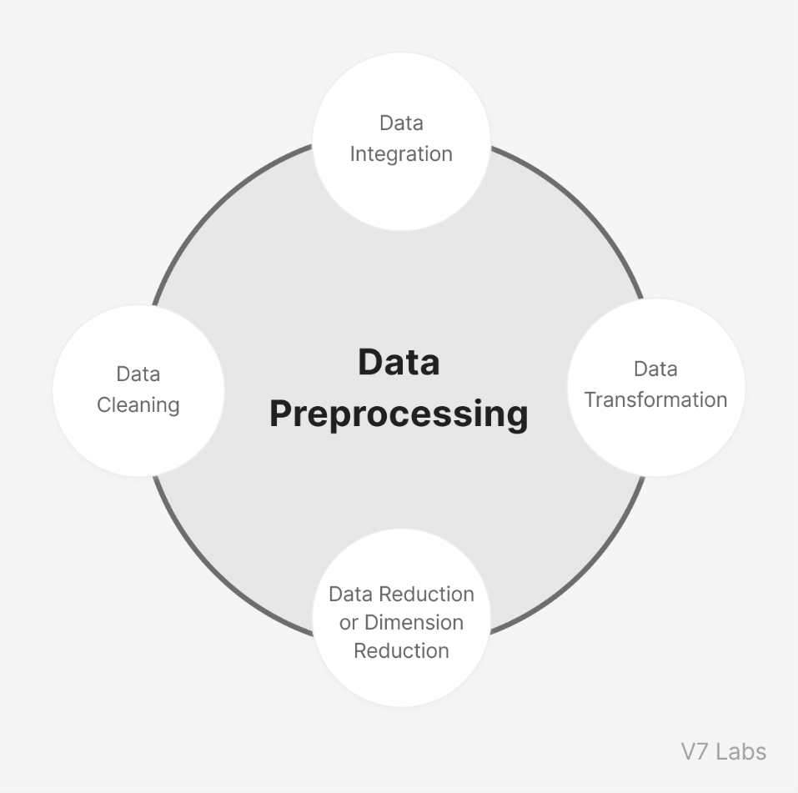
Data Preprocessing :
Data preprocessing is a critical step in using machine learning (ML) algorithms for CKD prediction, as it helps ensure that the data is clean, consistent, and ready for analysis. Here are some common steps for data preprocessing in CKD prediction using ML:
Data cleaning: This involves identifying and correcting errors or inconsistencies in the data, such as missing values, outliers, or incorrect entries. Depending on the severity of the errors, the data may need to be removed or imputed with estimates based on other data points.
Feature selection: Feature selection involves identifying the most relevant variables or features for predicting CKD. This can be done through statistical methods, such as correlation analysis or feature importance ranking, or through domain knowledge and clinical expertise.
Feature scaling: Scaling the features to a common range can help improve the performance of some ML algorithms. Common scaling methods include normalization or standardization

Slide 10
Training and Testing the Model :
The data is typically split into training and test sets. The training set is used to train the ML algorithm, while the test set is used to evaluate its performance. Cross-validation may also be used to further validate the model. We split the training and testing dataset into two parts in 8:2 ratio
The training dataset is used to train the data and the testing dataset is used to test the data

Slide 11
Choose Machine Learning Models :
We have developed a model using Machine learning Techniques used different classifiers and ensemble techniques to predict the Chronic Kidney Disease dataset
Kneighbors Classifier :
Training Accuracy: 98.4375% Test Accuracy: 97.5000%
SVC :
Training Accuracy: 99.0625% Test Accuracy: 98.7500%
Decision Tree Classifier:
Training Accuracy: 100.0000% Test Accuracy: 100.0000%
Random Forest Classifier :
Training Accuracy: 100.0000% Test Accuracy: 100.0000%
Gaussian NB :
Training Accuracy: 96.5625% Test Accuracy: 96.2500%
Logistic Regression :
Training Accuracy: 100.0000% Test Accuracy: 100.0000%

Slide 12
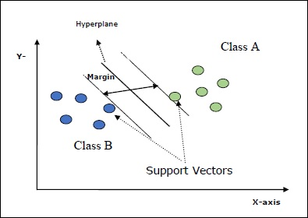
Support vector Classifier
Support Vector Classifier. It is a type of supervised learning algorithm used in machine learning and is a variation of Support Vector Machines (SVMs). The SVC algorithm is used for classification tasks where the data is separated into classes or categories. The algorithm works by finding the hyperplane that maximally separates the data points into different classes.
This algorithm is useful for classification tasks where the classes are not easily separable using linear separation, as it can use a kernel trick to transform the data into a higher-dimensional space where linear separation is possible.

Slide 13
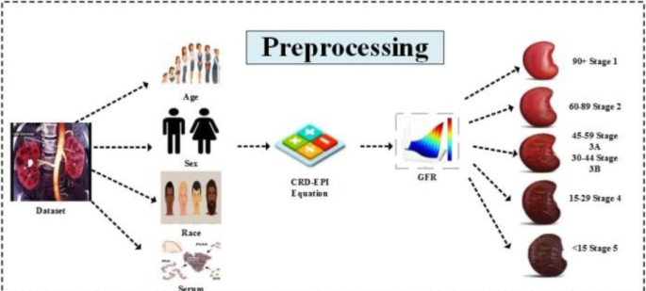
Decision Tree :
A decision tree is a type of supervised learning algorithm used in machine learning that is used for both classification and regression tasks. It is a tree-like model where each node represents a feature (attribute) of the data, each branch represents a possible value for that feature, and each leaf node represents a classification or a regression value
Decision trees are easy to interpret and visualize, and they can handle both numerical and categorical data. However, they can easily overfit the data if the tree is too complex or if the stopping criterion is not appropriate. This can be addressed by using pruning techniques, such as cost-complexity pruning or reduced-error pruning.

Slide 14
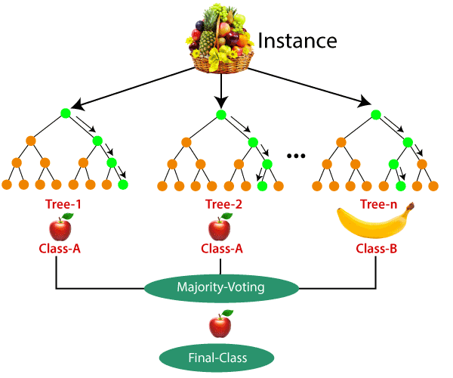
Random Forest :
Random Forest is a classifier that contains a number of decision trees on various subsets of the given dataset and takes the average to improve the predictive accuracy of that dataset
Instead of relying on one decision tree, the random forest takes the prediction from each tree and based on the majority votes of predictions, and it predicts the final output.

Slide 15
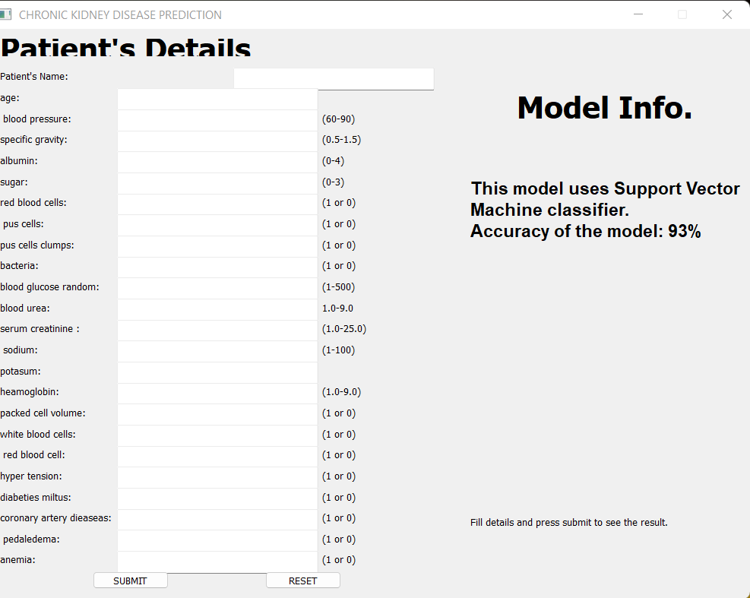
User Interface :
We created a graphical user interface using Python
It can be operated on any operating system like Windows, macOS, Unix.
We show the accuracy and which machine learning model is used to run the model.

Slide 16
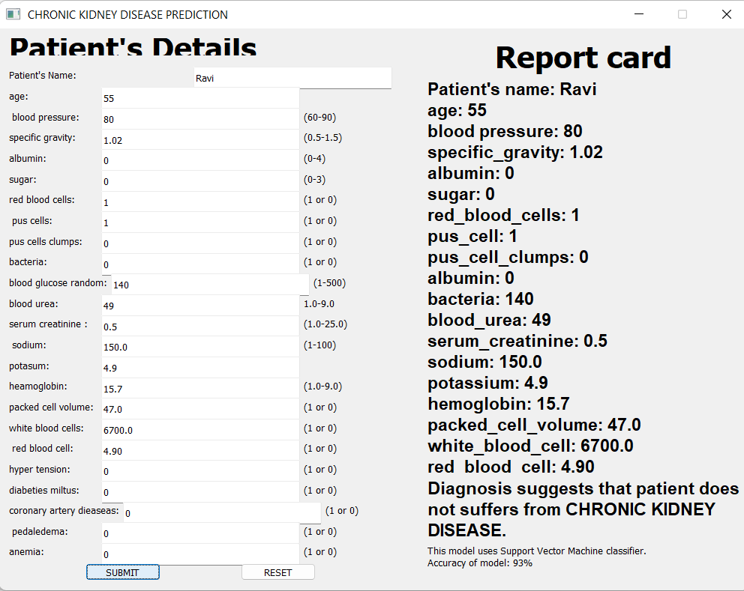
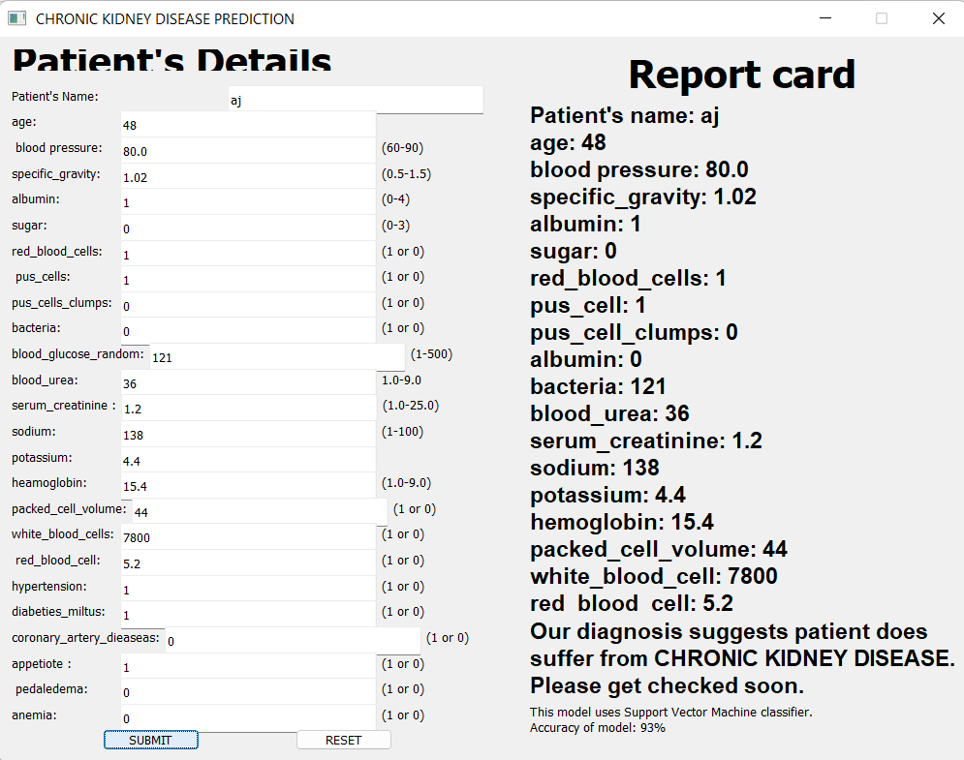
Result :
When a patient is not suffering from chronic kidney disease :
When a patient is suffering from chronic kidney
disease :

Slide 17
Conclusion :
Machine learning can be a valuable tool in predicting and managing chronic kidney disease (CKD). By analyzing large datasets of patient information, machine learning algorithms can identify patterns and risk factors that may not be immediately apparent to human analysts. This can lead to earlier identification of CKD and more effective treatment plans
Overall, machine learning has the potential to greatly improve our ability to identify, manage, and treat CKD. However, it is important to note that these algorithms are only as good as the data they are trained on, and careful consideration must be given to issues such as data bias and privacy concerns.

Slide 18


